Slide 1
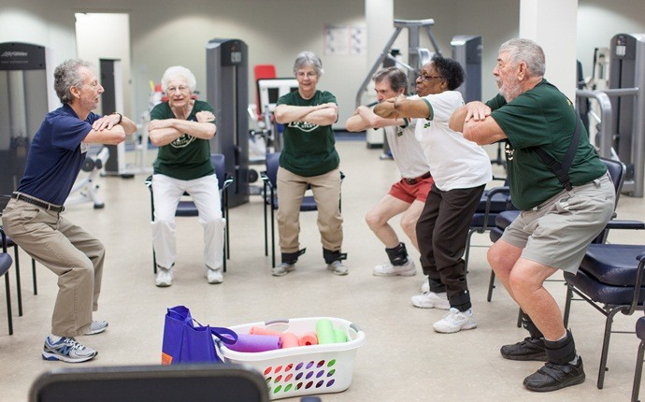
Functional Assessment And Training In Elderly
Dr. Sanskruti Tahakik
Dept. Of Community Physiotherapy
Mgm Institute Of Physiotherapy
Chh. Sambhajinagar

Slide 2
Contents
Objectives
Introduction
Functional Assessment of elderly
What is functional training
Recent advances

Slide 3
Objectives
Outline the purposes of evaluating the functional performance of older adults.
Discuss the different evaluation methods that might be used to asses older adults.
Discuss about functional training exercises with some recent advances and evidences available for older adults.

Slide 4
Introduction
The ability to perform Activities of Daily Living (ADL) is vital to living independently. Age-related loss in muscle strength can jeopardize this ability and lead to disability.
functional training may be more beneficial for improving ADL performance in older adults.

Slide 5
Function in the ICF is a umbrella term encompassing all body functions and structures, activities, and participation.
One of the major health problems facing older people is the risk of a decreased level of physical function.

Slide 6
An individual's level of physical performance is a reflection of their overall health, and the
Impact of several chronic diseases common among the elderly, such as arthritis, osteoporosis and coronary heart disease, on the ability to function without limitations in the course of daily life.
The physical function examination consists of exercises designed to measure particular aspects of musculoskeletal strength and flexibility in a standardized manner.

Slide 7
Overall all tests provide some insight into the individual’s capabilities to maintain a posture transition to other postures ,sustain safe and efficient movement.
Physical performance is commonly understood as the observable ability to perform tasks, e.g. chair rise.

Slide 8
Five times Sit to Stand Test:
Method: Use a straight back chair with a solid seat that is 16” high. Ask participant to sit on the chair with arms folded across their chest.
Instructions:
“Stand up and sit down as quickly as possible 5 times, keeping your arms folded across your chest.”
Measurement:
Stop timing when the participant stands the 5th time (Bohannon, 2006)
Meta analysis results “demonstrated that individuals with times for 5 repetitions of this test exceeding the following can be considered to have worse than average performance” (Bohannon, 2006) o 60‐69 y/o 11.4 sec o 70‐79 y/o 12.6 sec o 80‐89 y/o 14.8 sec

Slide 9
Functional training attempts to train muscles in coordinated, multi-planar movement patterns and incorporates multiple joints, dynamic tasks, and consistent alterations in the base of support for the purpose of improving function.
The principle of functional training is specificity of training which means that training in a specific activity is the best way to maximize the performance in that specific activity.

Slide 10
In order to improve performance in ADL, exercise training should be performed in similar movement patterns to how people perform daily tasks.
Functional training may be a better exercise program for older adults if the aim is to improve independence in ADL.

Slide 11
Evaluation Of Functional Performance
Evaluation has been defined as a determination of the value of or significance of a situation through careful appraisal and study.
Because of increasing rates of difficulties with functional performance, the evaluation of functional performance is essential.
Evaluation should be within patients home or community.

Slide 13
Donna J. Cech,functional Movement development across the life span, third edition

Slide 14
What to asses….??
Lower extremity performance including balance tests, repeated chair stands and 8-meter walk test.
Exercise capacity and tolerance- six minute walk test.
Functional mobility- the Environmental Analysis of Mobility Questionnaire (EAMQ).
ADL & IADL Functional Autonomy Measurement system.
Home safety the Safety Evaluation of Function and the Environment for Rehabilitation (SAFER-HOME)
*functional performance in older adults, B.R Bonder 2009 3rd edition page 438.

Slide 15
Systematic review of functional training on muscle strength, physical functioning, and activities of daily living in older adults
Chiung-ju Liu & Deepika M. Shiroy & Leah Y. Jones &Daniel O. Clark Eur Rev Aging Phys Act (2014) 11:95–106.
Results show beneficial effects on muscle strength, balance, mobility, and activities of daily living, particularly when the training content was specific to that outcome.
Studies were more focused on exercises simulating locomotor ADL such as walking, stair climbing, or chair stands.

Slide 16
Components Of A Functional Exercise Program
Based on functional tasks directed towards ADL’s.
Individualized
Integrated- it should include variety of exercises that work on flexibility, core ,balance strength and power.
Progressive – steadily increases the difficulty of task.
Performed in context-specific enviroments.

Slide 17
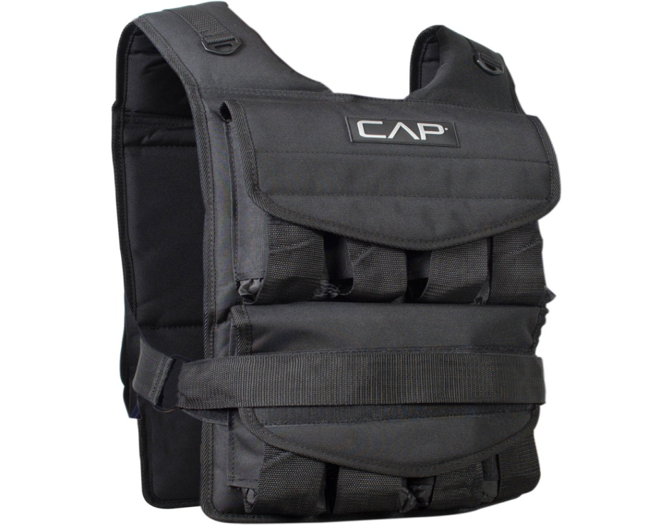
Subjects were trained on their ability to perform tasks with or without additional loads The intervention includes 5-minutes warm up and five minutes of cool down involves ROM exercises and stretches.
Then participants performed chair-rise and bed rise tasks for three repetitions.
Progression in sit to stand task made according to subjects ability
That is if subject is able to perform sit to stand task without use of hands on standard chair then weight is added by wearing a weight vest.

Slide 18
References
B.R Bonder Functional Performance in Older Adults, 2009 3rd edition.
AlexanderNB, Galecki AT, GrenierML, Nyquist LV, HofmeyerMR, Grunawalt JC et al (2001) Task specific resistance training to improve the ability of activities of daily living—impaired older.
Systematic review of functional training on muscle strength,physical functioning, and activities of daily living in older adults Chiung-ju Liu & Deepika M. Shiroy & Leah Y. Jones &Daniel O. Clark Eur Rev Aging Phys Act (2014) 11:95–106.
Donna J. Cech, Functional Movement Development across the life span, third edition.

